Slide 1


Introduction to Parallelism
Steve Crouch
Notes:
Welcome to an introduction to parallelism,
Where in this first episode, we'll introduce what we mean by parallelism,
And the key approaches and technologies we can use to parallelise our code

Slide 2
Learning Objectives
Describe the fundamentals of parallelisation and parallel programming
List the main characteristics of shared and distributed memory parallelisation, and how they apply to threads and processes
Describe the differences between data parallelism and message passing paradigms
Describe what is meant by an "embarrassingly parallel" problem
Notes:
So in terms of the things we'll learning about,
We'll look at the fundamentals of parallelisation and parallel programming
As well as two key perspectives of parallelisation - shared memory and and distributed memory,
And how they apply to threads and processes that we can use to parallelise our code
We'll also look at the key differences between data parallelism and message passing paradigms
And look at what is meant by an "embarrassingly parallel" problem

Slide 3
Introduction
Parallelisation: dividing a complex task into smaller subtasks, enabling simultaneous execution, to improve performance
Other ways to make code run faster
  Use a better compiler
  Develop/use more efficient theoretical methods
  Optimise the existing code
  Move computationally demanding parts (or whole program) into more performant languages
These reduce total amount of computation, increase efficiency
Notes:
Parallelisation (or parallelism) is a technique that allows us to divide a complex computational task into smaller subtasks,
enabling these smaller subtasks to be executed in parallel,
with the goal to improve performance - for example by allowing us to do more computation in the same period of time,
or to reduce how long it takes to do the same amount of computation
At some point in your career, you’ve probably asked the question “How can I make my code run faster?”. Of course, the answer to this question will depend sensitively on your specific situation, but here are a few approaches you might try doing.
You may use a better compiler - if you're using something like gcc to compile your code, if you have access to it, use a better more performant compiler
Such as vendor-specific compilers from Intel or AMD
And different compilers often work better for different types of problem
You could also develop or adopt more efficient theoretical methods
by essentially adapting the science to be more efficient,
and then reimplement the code according to this revised method
Alternatively, you might optimise the existing code
for example looking at your code and removing unnecessary computation
although sometimes optimising code makes your code less readable,
and then harder to understand and adapt in the future
And yet another way is to move computationally demanding parts (or whole program) into more performant languages
For example, taking code written in Python and rewriting all (or part of it) in C,
And using that instead
Although this can take a great deal of effort!
Each of the above approaches is certainly valid
Sometimes big gains can be had by analysing your code to understand where parts are not performing well
And doing something that works faster
And so such ways are intended to reduce the total amount of work required by the computer to run your code
Now a different strategy for speeding up codes is parallelisation
in which you split the computational work among multiple processing units that labor simultaneously to accomplish the work

Slide 4
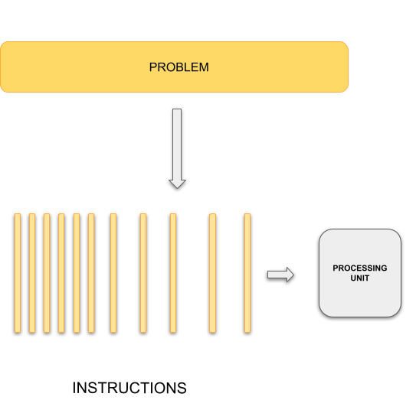
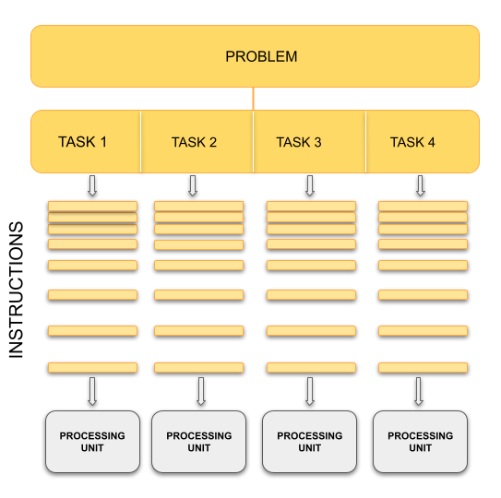
Sequential vs Parallel
Sequential in modern CPUs
  Mainly instruction follows instruction
  Perhaps some parallelisation, at a low level
Parallel
  Divide problem space across many processing 'units'
  In code - explicitly dictate how parallelism will occur
  Raises some interesting programming challenges
Sequential
Parallel
Notes:
Typical programming assumes that computers execute one operation at a time in the sequence specified by your program code
At any time step, the computer’s CPU core will be working on one particular operation from the sequence
In other words, a problem is broken into discrete series of instructions that are executed one after another
Therefore only one instruction can execute at any moment in time. We will call this traditional style "sequential computing"
The reality of this is a great deal more complex with modern CPUs
Modern CPUs actually perform a great deal of parallelisation in hardware anyway
Allowing the CPU to many types of operations simultaneously (where the program allows this to happen)
Employing methods such as branch prediction, for example
Where the CPU attempts to predict what your program will do next when it reaches a condition
And execute these possibilities simultaneously
Then, when it's known what your program did, one of those choices is valid, and it already has the answer
But techniques like this only go so far, and are low level
and only works within the context of a single CPU
And in many ways, the operation of your code is essentially sequential
However in parallel programs
The “processing units” might include central processing units (CPUs), graphics processing units (GPUs), vector processing units (VPUs), or something else
You explicitly dictate how parallelism will occur within your code in some way
And as we'll see with OpenMP and MPI, the ways this can be done within our code can be very different

Slide 5

Parallelism by Analogy
Painting four walls in a room
  Task of painting each wall is independent of others
Parallelism is dependent on available resources
  i.e. painters
If there is only one painter:
  Work on one wall, finish, work on another, repeat until done
Two or more:
  Complete job in parallel, painters assigned to "free" walls
  The more painters (up to 4), the more parallelism, the faster the job completes
Notes:
The basic concept of parallel computing is hopefully not too hard to understand
we divide our job in tasks that can be executed at the same time so that we finish the job in a fraction of the time that it would have taken if the tasks were executed one by one
Suppose that we want to paint the four walls in a room
We can divide our problem into 4 different tasks, with each task dedicated to painting one of the walls
For this case, our 4 tasks are independent from each other in the sense that we don’t need to finish one to start another
However, this does not automatically mean that the tasks can be executed simultaneously or in parallel
It all depends on on the amount of resources that we have for the tasks
In this case, the number of painters
If there is only one painter
they could work for a while in one wall, then start painting another one,
then work a little bit on the third one, and so on
The tasks are being executed concurrently but not in parallel and only one task is being performed at a time
If we have 2 or more painters for the job, then the tasks can be performed in parallel
And of course, the more painters we have (up to a maximum of 4), the more parallelisation can occur
And the faster the job will be completed
However, if we have more than four painters (and assuming only one painter can work on a wall at one time)
This doesn't help us
Since we only have four walls
So some painters are hanging around doing nothing, and would be a waste of resources
Conceptually, in compute resource terms, these types of scenario come up quite a lot

Slide 6
Parallelism: Processing and Memory
Parallelism not a simple problem
Typical computer: single CPU, RAM, hard disk
If we add a CPU, how do we handle memory?
  Cores share RAM, or each core has dedicated RAM?
  With shared memory - what happens when two cores write to it simultaneously?
  How do we divide and distribute tasks across cores?
  How to exchange data across cores?
  How do we handle collation/storage of results?
Notes:
Let's look at parallelism in general
It's simple in principle - we divide up our problem into pieces and process it over many cpus, computers, etc.
But technically, it's not a simple problem
Take a typical computer: single CPU, RAM, hard disk
Now if we add a CPU, let's take memory - how do we handle is over multiple cores?
Do we have it so that cores share RAM, or each core has dedicated RAM?
With shared memory - what happens when two cores write to it simultaneously?
How do we divide and distribute tasks across cores?
How to exchange data across cores (if data is needed for another part of a computation)?
How do we handle collation/storage of results?
That's a lot of very valid questions!
These considerations highlight the interplay between parallel processing and memory,
And the challenges we have in implementing parallelism.
So there are two things we need to understand
How to handle computation with respect to multiple cpus
And how to handle memory across them

Slide 7
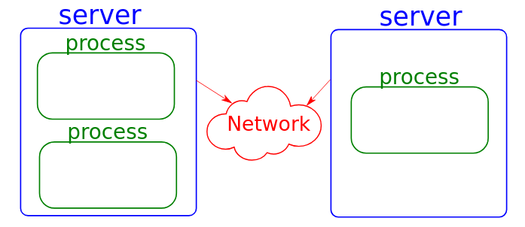

Processes vs Threads
Process-based (Message Passing Interface (MPI)
  Instance of a program being executed
  Operates independently, own resources
  Parallelism: run multiple processes, data exchange between processes with messages
Thread-based (OpenMP)
  Execution "unit" within a process
  Operates within a process, shares its resources
  More lightweight than processes, smaller scale
  Parallelism: run multiple threads in a process, manage concurrent data access
Notes:
From the computational perspective, it comes down to processes and threads.
Let's look at each of these in turn.
A process refers to an individual running instance of a software program
Each process operates independently and possesses its own set of resources, such as memory space and open files
As a result, data within one process remains isolated and cannot be directly accessed by other processes.
In parallel programming, the objective is to achieve parallel execution by simultaneously running coordinated processes
This naturally introduces the need for communication and data sharing among them
To enable this, parallel programming models like the Message Passing Interface (or MPI for short) have been developed
MPI provides a comprehensive set of libraries, tools, and methodologies
these enable processes to exchange messages, coordinate actions, and share data, enabling parallel execution across a cluster or network of machines.
A thread, on the other hand, is an execution unit that is part of a process
So it operates within the context of a process and shares the process’s resources
Unlike processes, multiple threads within a process can access and share the same data, enabling more efficient and faster parallel programming.
Threads are more lightweight
They are like the small building blocks of execution in parallel programming
So they're like the small-scale unit of parallelism
Whereas processes are the larger unit that can make use of many threads
One advantage of using threads on their own is that they can be easier to work with compared to processes when it comes to parallel programming
When incorporating threads, especially with frameworks like OpenMP, modifying a program becomes simpler
Since threads operate within the same process and can directly access shared data, this eliminates the need for complex inter-process communication required by mechanisms such as MPI
However, it’s important to note that threads within a process are limited to a single CPU core and a single computer
While they provide an effective means of utilizing multiple CPU cores on a single machine, they cannot extend beyond the boundaries of that computer
But using OpenMP can be a good first step in parallelising your code
If you need more parallelism, MPI can provide that, but at a higher overhead and implementation cost
So going back to our painting 4 walls analogy
Our example painters have two arms, and could potentially paint with both arms at the same time
Technically, the work being done by each arm is the work of a single painter
In this example, each painter would be a “process” (an individual instance of a program)
The painters’ arms represent a “thread” of a program
This raises the question of whether it's possible to use MPI and OpenMP at the same time,
To maximise the CPU resources you have
And yes, it is, and we cover this briefly later on in the course,

Slide 8
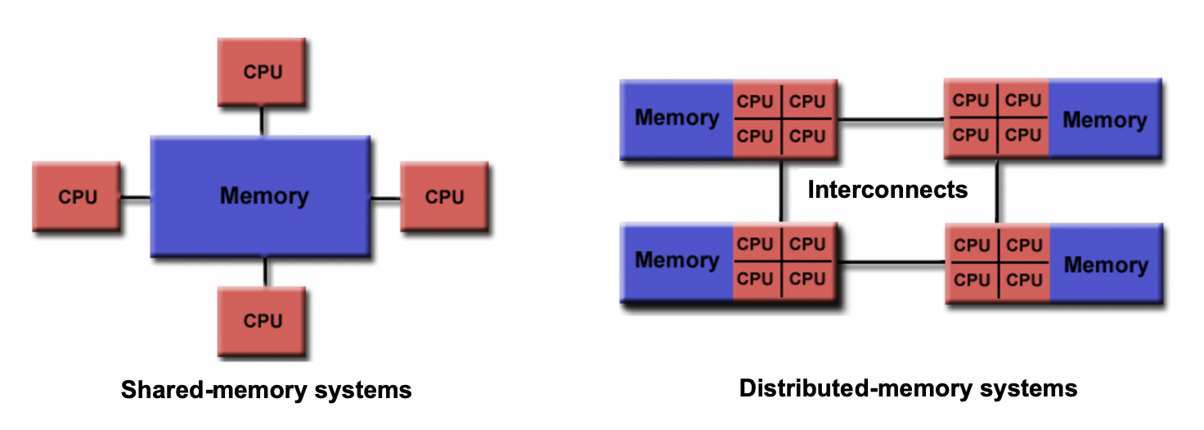
Shared vs Distributed Memory
Distributed memory (MPI)
  Processes have own private memory
  Sending/receiving messages explicit in code
  Therefore, any data exchange/synchronisation takes time
Shared memory (OpenMP)
  Multiple threads share same memory space
  Memory access mechanisms (largely) hidden from programmer
  Changes immediately visible to other threads
  Data parallelism paradigm
Notes:
Now let's look at memory access - another fundamental concept that
differentiates parallelism technologies such as MPI and OpenMP
We'll look at this in general terms, from the perspective of a "processor unit"
In MPI terms, this is a process
And in OpenMP terms, this is a threads
Distributed memory involves memory resources that are physically separated across different computers or nodes in a network
Each processor has its own private memory, and explicit communication is required to exchange data between processors
In distributed memory programming models, such as MPI, you need to explicitly exchange data between processes using messages, and within individual processes, update the process' memory, in things like variables
Shared memory, on the other hand, refers to a memory model where multiple processors can directly access and modify the same memory space
Changes made to variables by one processor are potentially immediately visible to all other processors
In shared memory programming models, like OpenMP, therefore have a simpler memory model and the underlying mechanisms for handling access to variables between threads is largely hidden from the programmer
But does need to be managed
So considering memory as a resource in a shared memory system, going back to our painting analogy:
Imagine painters have to obtain paint from a central dispenser in the middle of the room
If each painter is using a different colour, they can work independently
But if they use the same colour, and two run out of paint at the same time,
they have to synchronise their actions with the other painter in some way so they can use the dispenser
essentially, one waits until the other has finished using the resource

Slide 9
Parallelism Challenges
Race conditions: correct behaviour dependent on events in a certain order
Synchronisation: need to maintain consistent views of data across processors
Deadlock: two or more processors are unable to continue, since each is waiting for other(s) to release resources (e.g. messages)
Notes:
Now, very nature of parallelism gives rise to interesting challenges to do with simultaneous processing and memory handling
And these have to be accounted for when programming
Some key ones are
race conditions (where correct behaviour is dependent on events in a certain order which isn't guaranteed),
synchronisation (where we need to maintain consistent views of data across processors to ensure a correct result),
and deadlock (where two or more processors cannot continue due to waiting for other processors which are also waiting)
We'll be looking at some of these throughout the course

Slide 10
Types of Parallel Problems
Embarrassingly Parallel (EP) problems
  Easiest to understand and parallelise!
  Problem space divided across processors, each responsible for solving part of problem
  Each processor completely independent of the others
  e.g. Monte Carlo analysis, big data search, bulk processing of files (e.g. multiple image processing)
General (non-EP) problems
  Can't always parallelise all parts of a solution
  Typically - part of the problem solution dependent on another part
    More data dependency = more complex solutions
Notes:
Here's another perspective…
So what does all this mean in terms of how we approach parallel programming?
What does this mean for how we structure the problems we'll solve in parallel?
Let's look at two classes of problem…
The first of these is embarrassingly parallel - or EP - problems
These are the easiest to understand and parallelise
This is where the problem space can be simply divided across processors,
With each processor being responsible for a portion of the problem to solve
Examples of this are Monte Carlo simulation problems, big data search problems
In Monte Carlo simulations, some random element is used to determine the initial conditions for a simulation
Some parts of the simulation may finish quicker by a process, some may take longer
But it doesn't matter - each portion is computed independently of the others
For other classes of problem, let's call these general parallel (or non EP) problems
Sometimes not all parts of a solution can be parallelised
Usually, this is because part of the problem solution is dependent on the result of another part
Depending on the degree of data dependency, can mean solutions are more complex
An example of this is crystal simulation, used in things like drug discovery
The atomic simulation parts are often divided into domains
With processors responsible for a domain
But each domain needs to communicate with neighbouring domains,
to exchange results of processing that may affect them
Therefore, a great deal more data dependency, a great deal more complex a solution
Throughout this course we'll look at examples of both of these types of problem

Slide 11

Acknowledgements
www.software.ac.uk
Material developed for DiRAC in collaboration with
Notes:
That's all for this episode.
Thanks for listening!

